Slide 1
System Administration
Item Load and Inventory Load
Item (WMS)
Item (TMS)
WMS Guide

Slide 2
Table of Contents
Item Load........................................................................................................................3
Inventory Load..............................................................................................................28
Item (WMS) ..................................................................................................................43
Item (TMS)…..................................................................................................................90

Slide 3
Item Load
Back to the Table of Contents

Slide 4
Item Load
Items in the WMS are specified with a wide variety of attributes which can be defined through the Item Load resource.
The Item Load resource is similar to the Item Management resource (which is more detailed). The Item Load resource has been customized to reflect the minimum fields required for item configuration in the WMS.

Slide 5
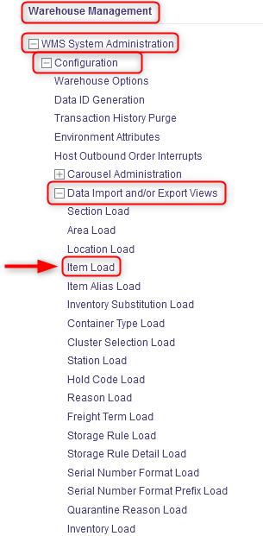
Item Load
With a desktop computer, use the Warehouse Management menu.
Select the WMS System Administration resource.
Under WMS System Administration, click on Configuration.
Under Configuration, click on Data Import and/or Export Views.
Under Data Import and/or Export Views, click on Item Load.

Slide 6
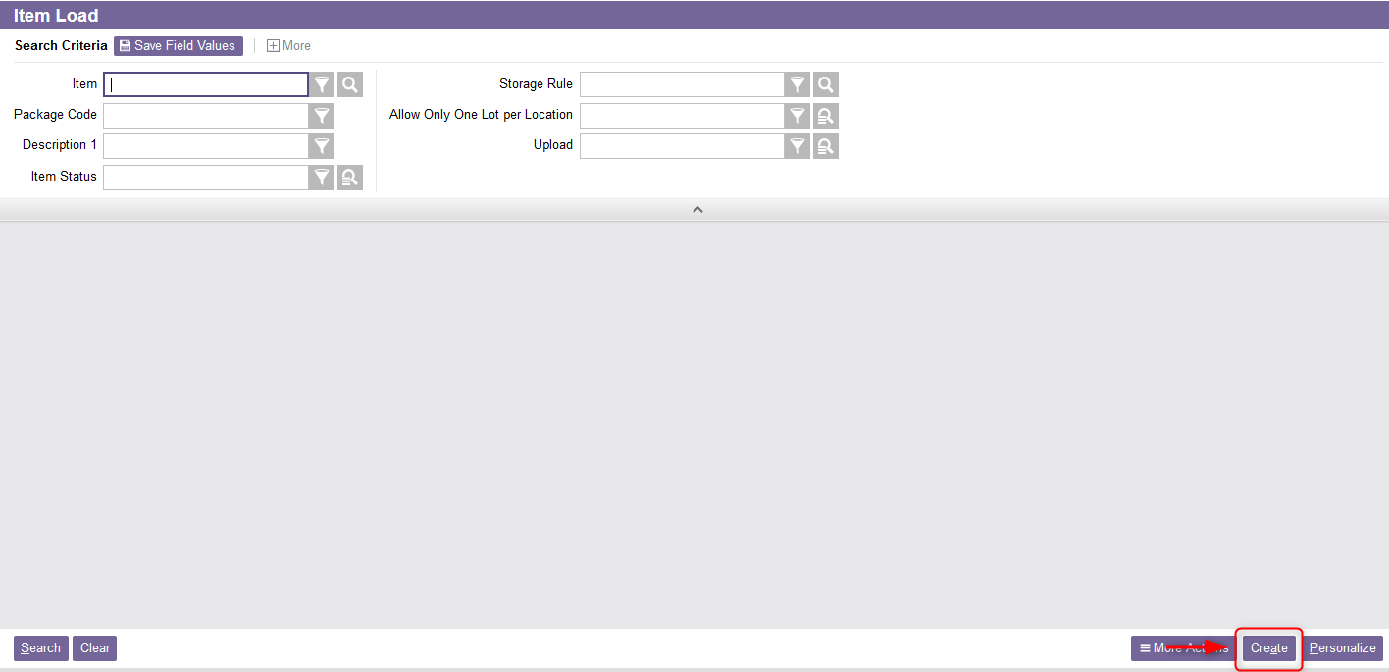
Item Load
From the new window, select the Create action.

Slide 7
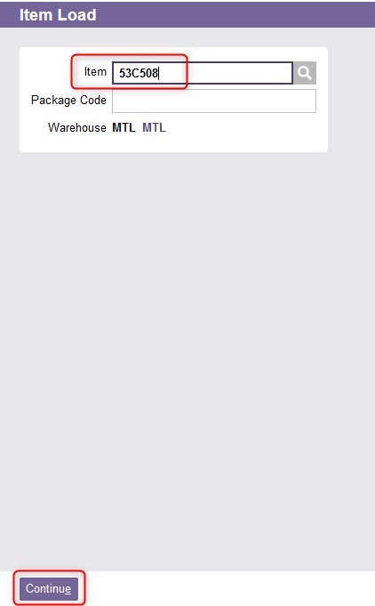
Item Load
A new Item Load window will appear. Enter the Item number you wish to load.
Click Continue.

Slide 8
Item Load
The item's detailed view appears from which you can fill in the various fields required for the following sections:
  General
  UOMs
  Volume and Weight
  Receiving
  Default Input Settings
  Other Information

Slide 9
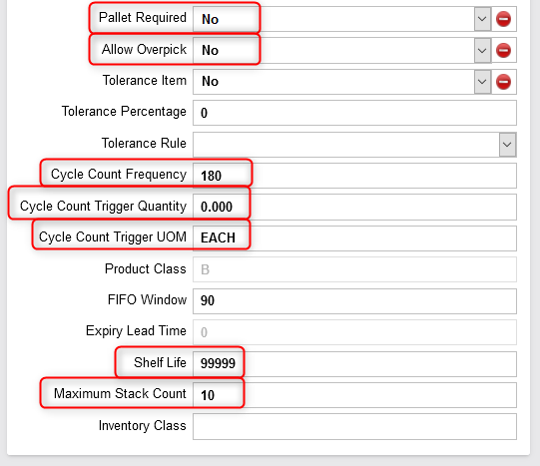
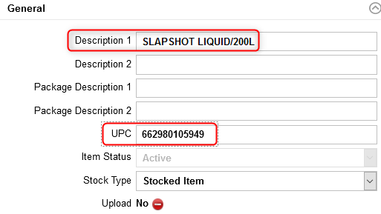
Item Load
Complete the General section at least for the following fields: Description 1, UPC, Stock Type, Pallet Required, Allow Overpick, Cycle Count Frequency, Cycle Count Trigger Quantity, Cycle Count Trigger UOM, Shelf Life , Maximum Stack Count. An explanation of the fields is given in the next slides.

Slide 10
Item Load
(Continued)
Field | Explanation
Description 1 | Short description of the item. This is the description that appears on mobile equipment for commands involving inventory of this item.
UPC | The universal product code for this item. This value is usually downloaded from the DMS.
Pallet Required | A value of Yes indicates that the system consider that the item is always a palletized unit load, regardless of the actual quantity to be stored. A value of No indicates that there is no special pallet requirement for the item.
Allow Overpick | Usually this field is set to No except for packaging or labels. A value of Yes indicates that the item may be over-picked. If allowed and 90% of a pallet is to be picked, the user may choose to pick the whole pallet rather than break the pallet at the point of picking. The product may be relocated through the Inventory Relocation or the Move resources. A value of No indicates that the system will not allow a user to pick more than the ordered quantity for the line item.

Slide 11
Item Load
(Continued)
Field | Explanation
Cycle Count Frequency | The number of days between automatically scheduled cycle counts for an item.
Cycle Count Trigger Quantity | The cycle count trigger quantity for an item. Default value is 0. When a pick or replenishment is performed from a location, and the remaining quantity in the location is less than or equal to this trigger quantity, the system automatically generates a cycle count for the location.
Cycle Count Trigger UOM | The unit of measure for the quantity specified in the Cycle Count Trigger Quantity field.
Shelf Life | The shelf life, in number of days of the item. Usually the value is set to 99999.
Maximum Stack Count | The maximum number of loads that can be stacked vertically in a location. Example: The number of pallets which can be stacked on top of one another.

Slide 12
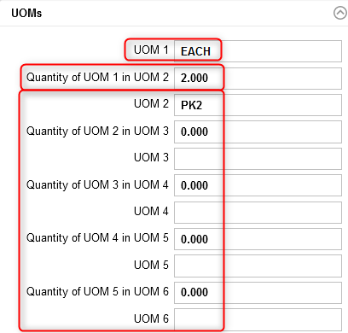
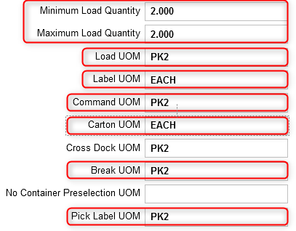
Item Load
If you are loading a new item, complete the UOM section. If you are updating an item for which there is inventory in the warehouse, this section cannot be edited in the Item Load resource, refer to the Item UOM Maintenance section of this document to update these fields. An explanation of the fields is given in the next slides.
Automatically calculated by the system
Mandatory
Optional

Slide 13
Item Load
(Continued)
Field | Explanation
UOM 1 | The level 1 unit of measure. This field is mandatory.
Quantity of UOM 1 in UOM 2 | Given that UOM 1 is the stocking unit of measure, the number of UOM 1 it takes to make one UOM 2.
UOM 2 to 6 | These fields are optional. The level 2 to 6 unit of measure. If specified, UOMs 1 to 6 must be unique.
Minimum Load Quantity | The minimum quantity (in the lowest unit of measure) of inventory that can be associated with a full load for the item. This field is automatically calculated by the system based on the Load UOM field.
Maximum Load Quantity | The maximum quantity (in the lowest unit of measure) of inventory that can be associated with a full load for the item. This field is automatically calculated by the system based on the Load UOM field.

Slide 14
Item Load
(Continued)
Field | Explanation
Load UOM | Quantity per Tag which defines the unit of measure for which a tag ID is generated. The load unit of measure is the item's normal handling unit of measure that controls the creation of unique tags and inventory records at the time of receiving. This value must represent either UOM 1, UOM 2, UOM 3, UOM 4, UOM 5 or UOM 6.
Label UOM | The unit of measure for which tag labels are printed on a receipt record. The label unit of measure controls the number of bar code license plate tags generated at receiving. Label UOM should not be confused with Load UOM since a single unit load could generate many labels, each with the same tag ID. In this example, 2 labels will be generated because the value is set to EACH for a pack of 2. This value must represent either UOM 1, UOM 2, UOM 3, UOM 4, UOM 5 or UOM 6.
Command UOM | The command unit of measure controls how quantity information is communicated to users for all work-related tasks (e.g. picking or store using a RF gun. Commands are displayed to users in this unit of measure whenever possible.

Slide 15
Item Load
(Continued)
Field | Explanation
Carton UOM | Unit of measure that defines a shipping carton that can be shipped directly to a customer as is. It is used to calculate the number of cartons on shipping paperwork (i.e. the bill of lading). This value must represent either UOM 1, UOM 2, UOM 3, UOM 4, UOM 5 or UOM 6.
Cross Dock UOM | The minimum unit of measure that can be cross docked for an item. This field is not used.
Break UOM | The lowest unit of measure allowed when picking this item.
Pick Label UOM | The largest unit of measure for which a pick label will be printed. Example: if the command unit of measure is PALLET, and the pick label unit of measure is CASE, when a pallet is required (with10 cases per pallet), therefore 10 labels will be printed for the pallet. This value must represent either UOM 1, UOM 2, UOM 3, UOM 4, UOM 5 or UOM 6, may not be greater than the Command UOM and not be less than the Break UOM.

Slide 16
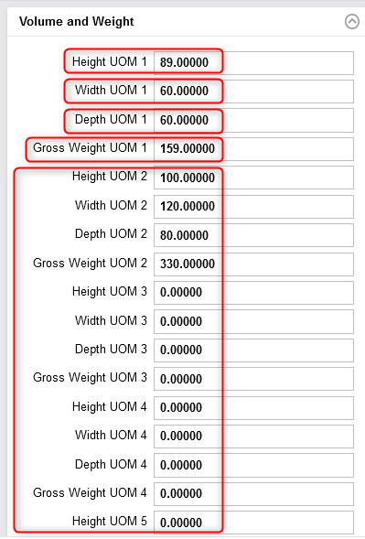
Item Load
If you are loading a new item, complete the Volume and Weight section. If you are updating an item for which there is inventory in the warehouse, this section cannot be edited in the Item Load resource, refer to the Item Volumetrics Maintenance section of this document to update these fields. An explanation of the fields is given in the next slides.

Slide 17
Item Load
(Continued)
Field | Explanation
Height UOM 1 | The level 1 height of the specified unit of measure inventory.
Width UOM 1 | The level 1 width of the specified unit of measure inventory.
Depth UOM 1 | The level 1 depth of the specified unit of measure inventory.
Gross Weight UOM 1 | The level 1 gross weight of the specified unit of measure inventory.
If the corresponding UOM is entered for the Height UOM 1, Width UOM 1, Depth UOM 1 and Gross Weight UOM 1, then the corresponding height/width/depth must also be entered. These fields are mandatory.
Height UOM 2 to 6 Width UOM 2 to 6 Depth UOM 2 to 6 Gross Weight UOM 2 to 6 | These fields are optional depending on whether you entered a value for UOM 2 to 6. The explanation is the same as above.
Notes:
:

Slide 18
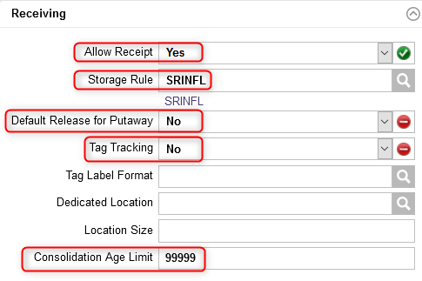
Item Load
Complete the Receiving section for the fields shown below. An explanation of the fields is given in the next slide.
Always set to Yes
Always set to No
Set to No

Slide 19
Item Load
(Continued)
Field | Explanation
Allow Receipt | A value of Yes indicates that inventory of this item may be received in the warehouse. A value of No indicates that inventory of this item cannot be received. This field is always set to Yes.
Storage Rule | This is the storage rule to follow when an item is received. Storage rules instruct the WMS how to find a storage location to support the putaway process.
Default Release for Putaway | A value of Yes indicates that the item will be released for storage automatically during receiving. A value of No indicates that the item will not be released for storage. By setting this value to No, the inventory will be temporarily placed on hold until the user releases manually the inventory for putaway via the Release for Putaway resource. This field is always set to Yes.
Tag Tracking | A value of Yes indicates that the item is tag-tracked. This field is set to No as the tag tracking is usually done at the location level.
Consolidation Age Limit | The relative age, in number of days, that is used for consolidation. During location selection, inventory will not be consolidated with other inventory that differs in age by more than the consolidation age. The value given to this field is always the highest.

Slide 20
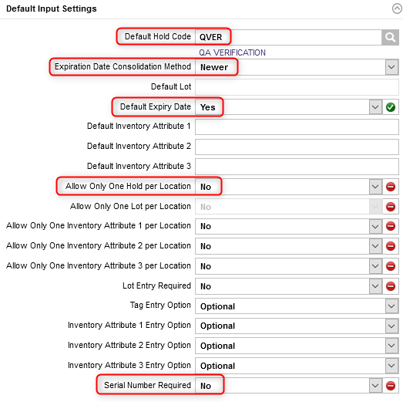
Item Load
Complete the Default Input Settings section for the fields shown in the opposite figure. An explanation of the fields is given in the next slide.
Set to Yes
Always set to Yes
Field downloaded from the DMS

Slide 21
Item Load
(Continued)
Field | Explanation
Default Hold Code | The default hold code to be used for the item during receiving. For some reason, this enables to keep separate the item from similar inventory for Quality Check or in the event of a new item for example.
Expiration Date Consolidation Method | This is used when updating the item's expiration date when the inventory is being consolidated. “Destination” indicates that the inventory will be updated with the item expiration date of the inventory record currently in the destination location being consolidated. “Older” indicates that the inventory will be updated with the older item expiration date of the inventory records being consolidated. “Newest” indicates that the inventory being consolidated will be updated with the newer item expiration date of the inventory records being consolidated. Example: By indicating "Newest", if a product currently in stock received last week is mixed with the same product received this week, then the expiration date will be that week.

Slide 22
Item Load
(Continued)
Field | Explanation
Default Expiry Date | A value of Yes indicates that the item expiration date will be equal to the receipt date plus the shelf life. A value of No indicates that the item expiration date must be entered by the user. This field is set to Yes.
Allow Only One Hold per Location | This determines whether the inventory can be stored in a location that already has inventory or if it needs to be placed in another location. This field is always set to No. A value of No indicates that any hold code can be placed into the location with the same item.
Serial Number Required | A value of Yes indicates that a serial number is required for this item. A value of No indicates that a serial number is not required for this item. This value is downloaded from the DMS

Slide 23
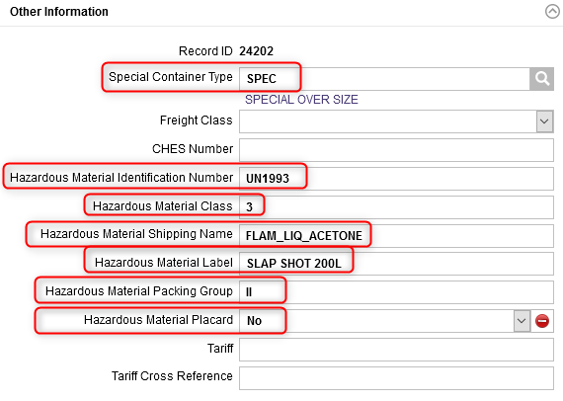
Item Load
In the case of a hazardous material only, complete the Other Information section for the fields shown below. An explanation of the fields is given in the next slide.
Provided by the MSDS
Provided by the MSDS
Managed by the TMS, always set to No

Slide 24
Item Load
(Continued)
Field | Explanation
Special Container Type | Wave release will always assign this container type for the item during picking and will exclude this item from the regular container.
Hazardous Material Identification Number | The hazardous material identifier provided by the Material Safety Data Sheet (MSDS).
Hazardous Material Class | The hazardous material classification.
Hazardous Material Shipping Name | The hazardous material proper shipping name for this item. Refer to the next slide for more details.
Hazardous Material Label | The description/code used for hazardous labeling for the item.
Hazardous Material Packing Group | The hazardous group material classification provided by the MSDS.
Hazardous Material Packing Placard | A flag that indicates if hazardous placards are required. This field is managed via the TMS and is always set to No.

Slide 25
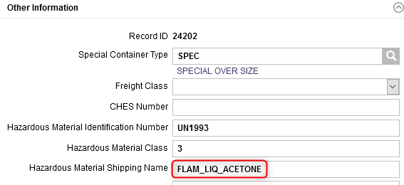
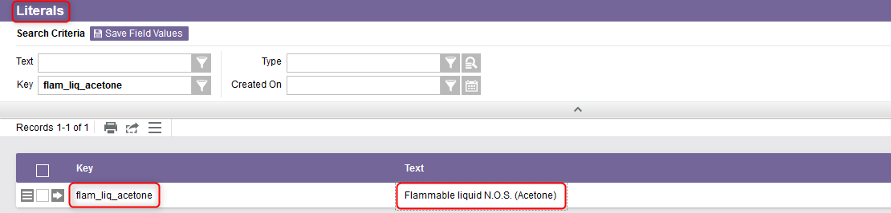
Item Load
Additional Note – The Hazardous Material Shipping Name in the Item Load resource is a code (or key) in the WMS and which refers to a text value. This text value corresponds to the real description of the item for shipping purposes. The real description of the item can be found in the Literals resource.

Slide 26
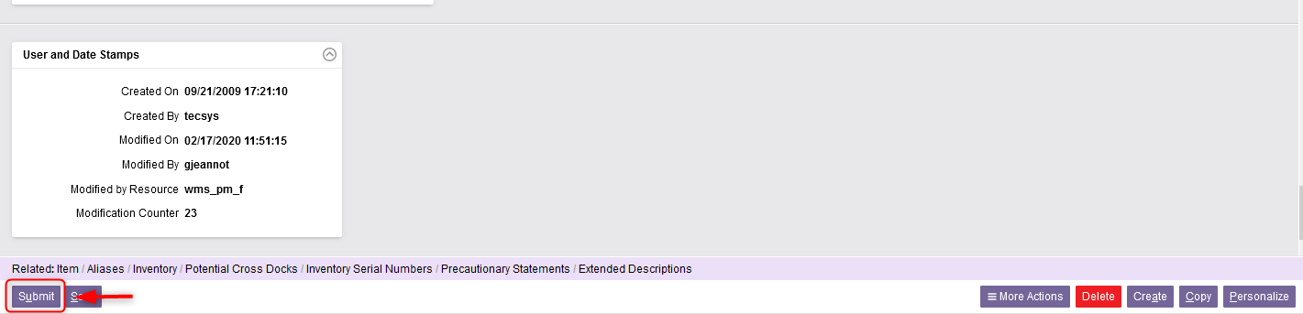
Item Load
Once all the required fields in the sections have been completed, click Submit.
Click on Close to exit the Item Load resource.

Slide 27
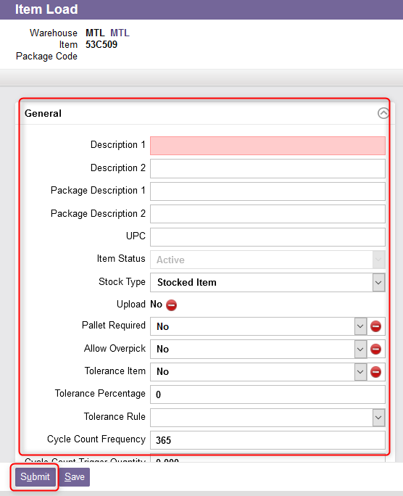
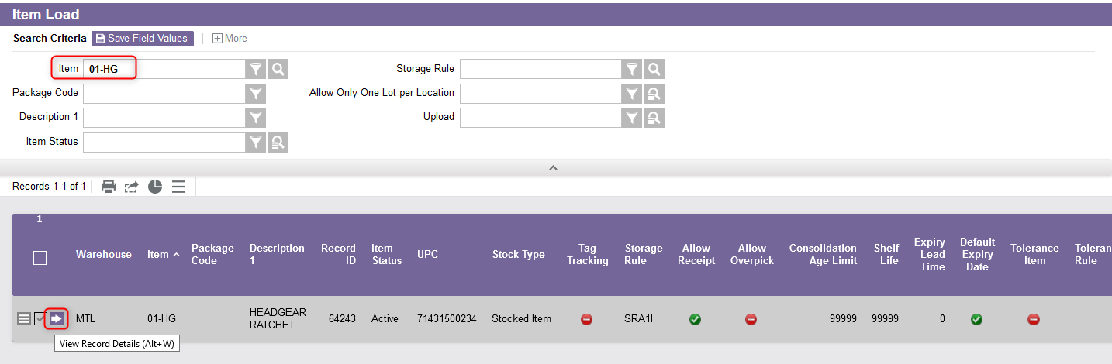
Item Load
Additional Note – If you just want to update data for a particular item, from the Item Load resource:
Perform a search to retrieve the item you wish to update,
Select the View Record Details,
From the new window, update the desired fields as explained previously,
Click on Submit.

Slide 28
Inventory Load
Back to the Table of Contents

Slide 29
Inventory Load
The Inventory Load resource is part of the initial WMS configuration process.
This resource is used to load the initial existing inventory of items into the system.
Only one receipt may be prepared (reserved) by a given user at any one time. While a given receipt is reserved, no other user can access it.

Slide 30
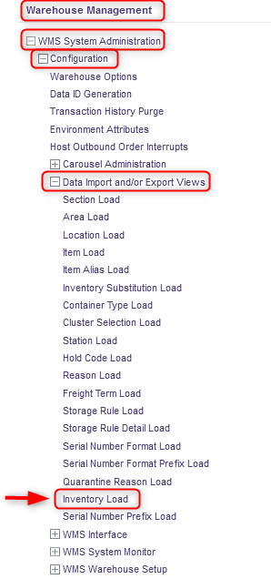
Inventory Load
If you want to load inventory for an item into the WMS:
With a desktop computer, use the Warehouse Management menu.
Select the WMS System Administration resource.
Under WMS System Administration, click on Configuration.
Under Configuration, click on Data Import and/or Export Views.
Under Data Import and/or Export Views, click on Inventory Load.

Slide 31
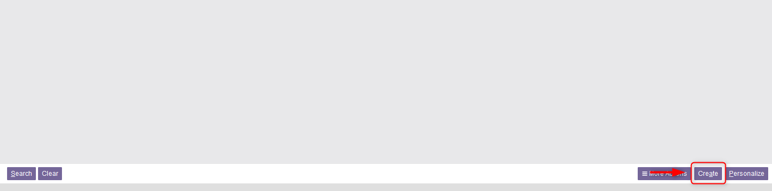
Inventory Load
From the Inventory Load Resource, click on Create at the bottom right of your screen.

Slide 32
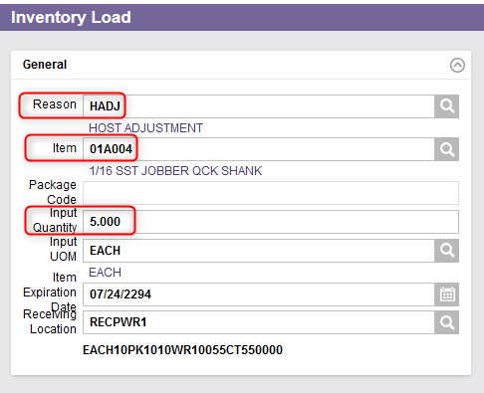
Inventory Load
Enter a Reason for the receipt.
Enter the item number from the inventory.
Enter the received quantity in the Input Quantity field as well as the corresponding UOM in the Input UOM field.
The default value for the UOM is set to the value of the item's UOM 1 field, as defined in the items table, but it can be overridden with the item's UOM 2, UOM 3 or UOM 4 if needed.

Slide 33
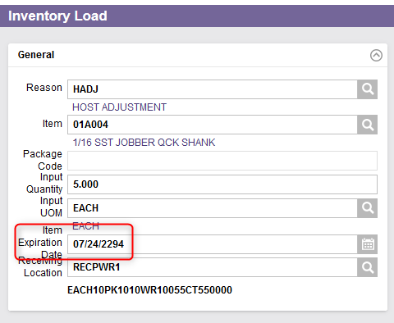
Inventory Load
Enter the Item Expiration Date as shown on the product's packaging.
If the Default Expiry Date field in the items table is set to No, this is a required field.
If the Default Expiry Date field in the items table is set to Yes, the expiry date is calculated using the current system date plus the item's shelf life.
If an existing lot is used, the Default Expiry Date should default from the lot.

Slide 34
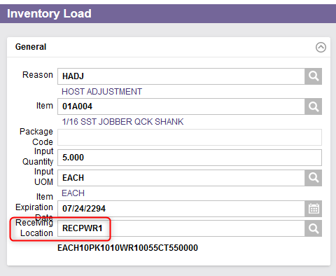
Inventory Load
The Receiving Location field will be defined by default with a value retrieved from the default receiving warehouse assigned to the station set up for the user in the WMS users table.
This is the location into which the inventory has already been received and from which the inventory will be retrieved for putaway.
You may enter a location for a direct store (i.e. a location for which the type is FIFO, LIFO or BULK). In the case of a location that is assigned a forward pick item, your entry is allowed only if the forward pick item is the same as the item being received.

Slide 35
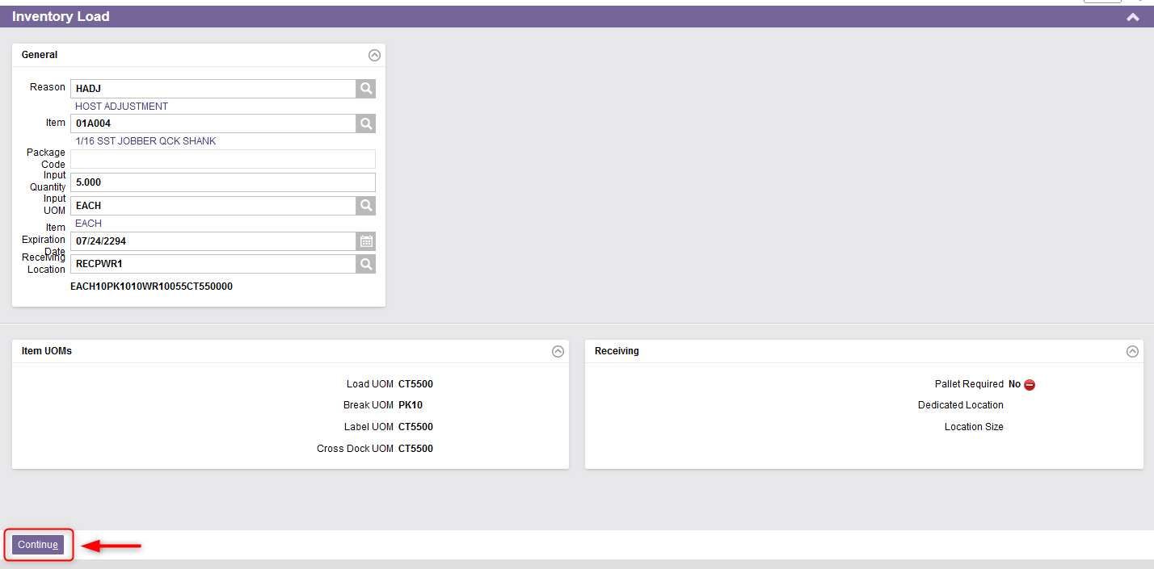
Inventory Load
Once all the fields properly entered, click on Continue.

Slide 36
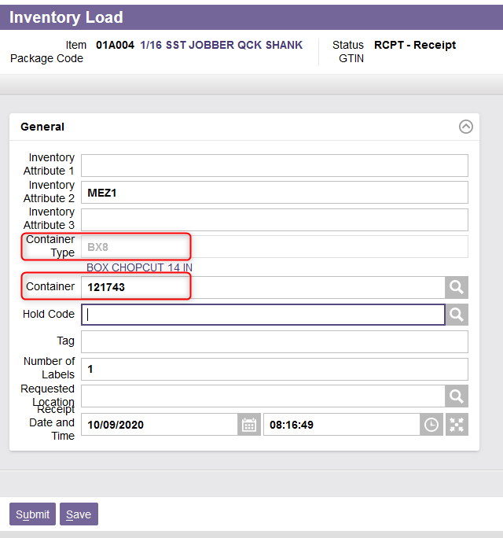
Inventory Load
A new window will appear. Enter a Container Type and a Container if applicable.
The container is the container number in which the inventory will be moved and/or stored.
The container type is the type code for the container in which the inventory will be moved and/or stored.

Slide 37
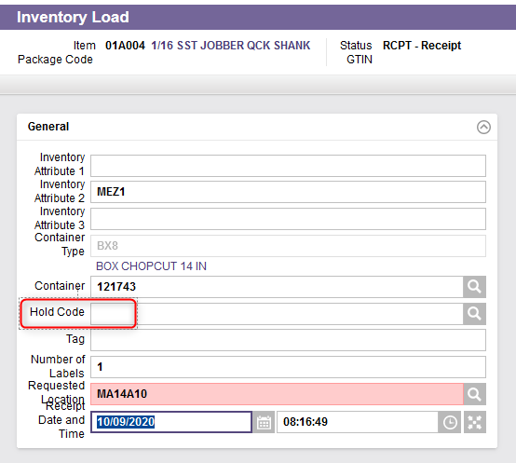
Inventory Load
Optionally, enter a Hold Code.
The hold code provides a means to identify inventory that is to be kept separate from similar inventory for disposal, a return to the vendor, testing, or inspection purposes. The hold code may be for a full or partial load.

Slide 38
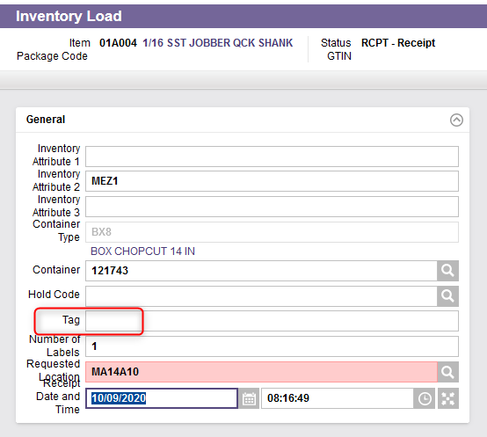
Inventory Load
Optionally, enter a Tag.
This is the specific tag number requested for the inventory being received or released.
The requested tag must be unique. If no tag number is specified, the system assigns tag numbers using the next available sequential number obtained from the data ID generation table.

Slide 39
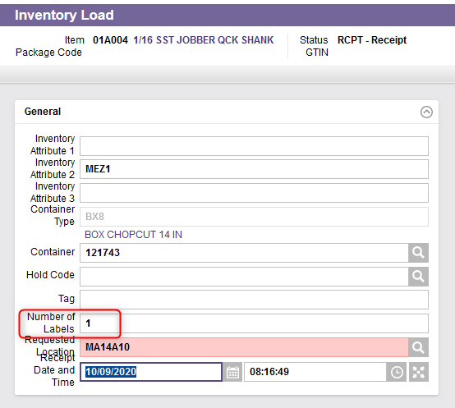
Inventory Load
Optionally, change the Number of Labels.
The number of labels is calculated from the Receipt Quantity and Order UOM, as well as the Label UOM field from the items table.
The number of labels is given an initial value based on the Quantity Balance (i.e., the expected receipt quantity) but can be adjusted as desired.

Slide 40
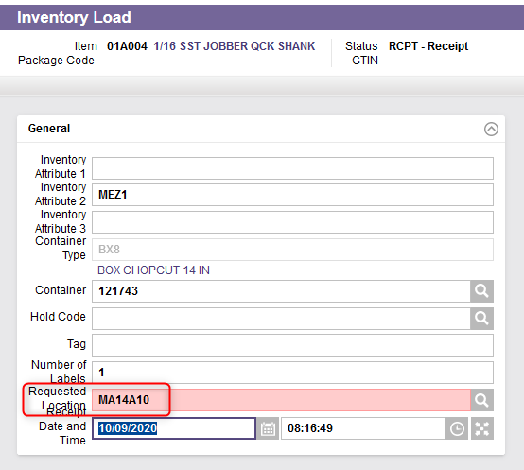
Inventory Load
Optionally, enter a Requested Location.
This is the location into which the user has requested the inventory be stored after the receiving process.
The receiving location must be different than the requested location.

Slide 41
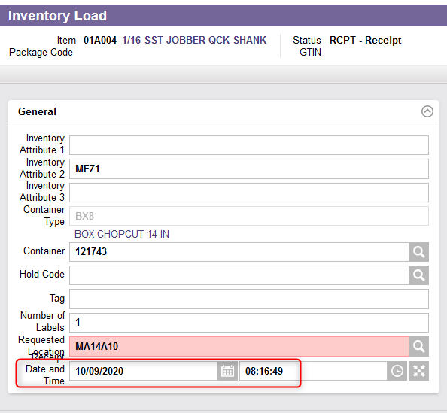
Inventory Load
Optionally, change the Receipt Date and Time.
This is the date used to determine the age of the inventory and used for inventory selection.
When this value is modified, the values of the Rotation Date and Time and Item Expiration Date are recalculated and displayed.

Slide 42
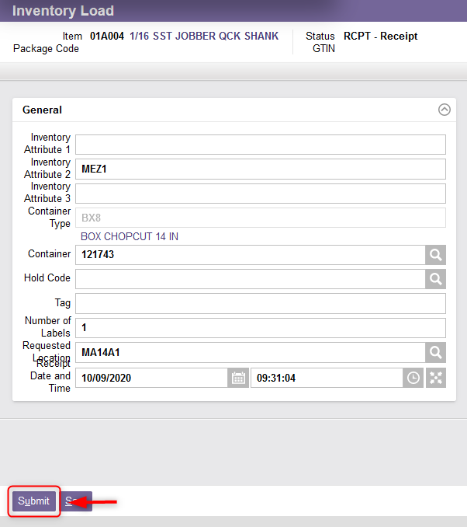
Inventory Load
Once all the fields properly entered, click on Submit.
Inventory for the product has been loaded into the system.

Slide 43
Items (WMS)
Back to the Table of Contents

Slide 44
Items (WMS)
The Items resource is used to add, modify, copy, delete the records in the items table and in its child, the item extended descriptions table and to query the records in the item and item extended description tables.
An item is the identification of a type of inventory handled within a facility. An item record contains information that allows the creation and management of consistent inventory using product specific characteristics such as dimensions, weight, default receiving information, and special handling and storage requirements.
When an item number is specified during the inventory creation process, the system looks up the item in this table and generates receipt and inventory records based on the item definition.

Slide 45
Items (WMS)
Through this resource you can:
  Update the item configuration of a Host uploaded item,
  Create and configure a non-uploaded item.
The prerequisites are:
  The item is created in the Host system and downloaded, via an interface, to WMS (for upload items),
  A WMS storage rule exists (for upload and non-upload items),
  An Item is physically available, or its physical characteristics are available (for upload and non-upload items).

Slide 46
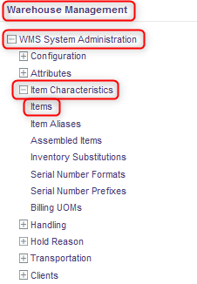
Items (WMS)
With a desktop computer, use the Warehouse Management menu.
Select the WMS System Administration resource.
Under WMS System Administration, click on Item Characteristics.
Under Item Characteristics, click on Items.

Slide 47
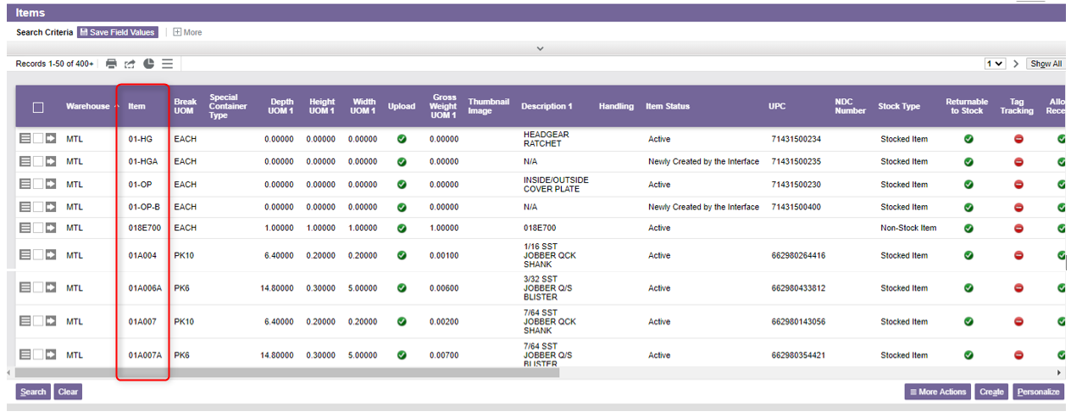
Items (WMS)
In the new window, the existing items in the WMS will be listed.

Slide 48
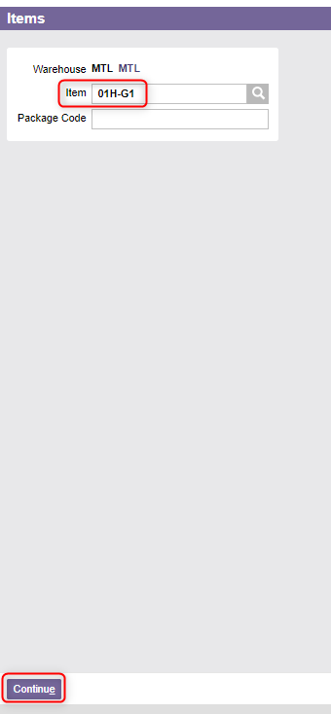
Items (WMS)
To create a new item or to update an existing upload item:
6.1 If the item does not exist:
6.1.1 Click on Create at the bottom right of your screen.
6.1.2 From the new window, enter the Item.
6.1.3 Click on Continue.

Slide 49
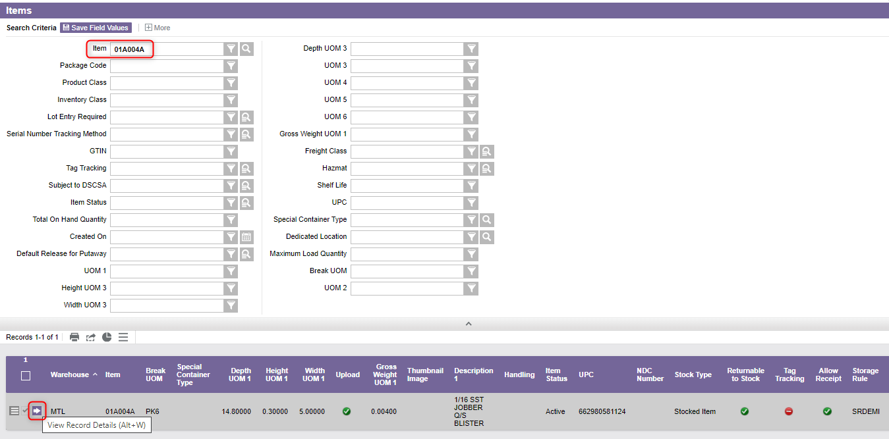
Items (WMS)
(Continued) To create a new item or to update an existing upload item:
6.2 If an upload item exists:
6.2.1 Perform a search to retrieve the item to be updated,
6.2.2 Click on View Record Details.

Slide 50
Items (WMS)
From the new window, the following sections can be completed (for new non-upload item) or updated (for existing upload item):
General
Receiving
Default Input Settings
UOM1
UOM 2 to 6
UOMs
Item Precautionary Statements
Serial Tracking
Shipping
Cycle Counting
Hazardous Material Handling
Item Extended Description

Slide 51
Items (WMS)
(Continued) Additional Note – When dealing with an upload item, the following fields are populated by the host to WMS and cannot be changed in WMS:
Item ID
Description 1 and Description
Package Description 1 and Package Description 2
UPC
Stock Type
Upload
Product Class
Expiry Lead Time
UOM1
GTIN1
Lot Entry Required
Default Expiry Date
Allow Only One Lot per Location
Serial Number Required

Slide 52
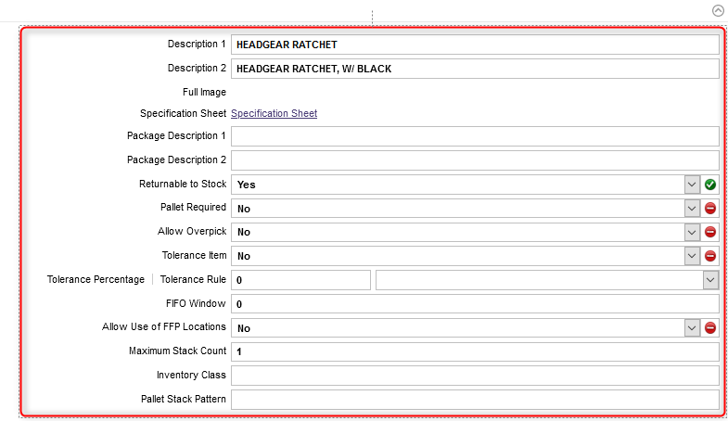
Items (WMS)
In the General section, enter the item configuration. An explanation of the fields is given in the next slides.

Slide 53
Items (WMS)
(Continued)
Field | Explanation
Description 1 & 2 | The description of the item for language 1 & 2 users.
Package Description 1 & 2 | A description of the package code for the item for language 1 & 2 users. This field is often used to capture the pack/size of an item.
Returnable to Stock | Indicates whether the item is considered returnable to stock when being processed through the Express Returns resource. Yes indicates that the storage rule assigned to the item will be used to find a storage location for the returned quantity. No indicates that the item's storage rule will not be used during the Release action when processed through the Express Returns resource for the returned quantity. The storage location will be extracted from the Non-Returnable to Stock Disposal Location field in the Warehouse Options resource, if applicable. Also, the non-returnable to stock hold code will be applied to the inventory from the Warehouse Options resource, if applicable
Pallet Required | This determines whether a pallet is required for the storage of any quantity of the item, so the volumetric calculations should always be based on the Load UOM.
Allow Overpick | Indicates if picking more than the ordered quantity of the line item is allowed.

Slide 54
Items (WMS)
(Continued)
Field | Explanation
Tolerance Item | This indicates if tolerance picking is applicable to the item/package code for any product that does not consistently have a uniform quantity associated with some or all its units of measures.
Tolerance Percentage | The acceptable variance allowed while over-picking product for an order.
FIFO Window | Number of days which is considered equal in terms of FIFO. Used with FIFO Window Search Path to find inventory which is older than the TAG found by this many days.
Allow Use of FFP Location | This determines if Floating Forward Pick (FFP) locations will be used for this item. Used with order planning to see if a FFP can be used or not.
Maximum Stack Count | The maximum number of loads, as defined by the Load UOM, that can be stacked vertically in a location
Inventory Class | An inventory category that may be used to generate planned cycle counts. This concept is used to slot warehouse families together within the facility for reasons to do with weight, stack ability, fragility, hazardous needs, security, and so on. This field is manually maintained and serves as a memo field for cycle counting or reporting purposes only.
Pallet Stack Pattern | The user-defined TI-HI pattern to be followed when stacking cartons of this item/package code onto a pallet.

Slide 55
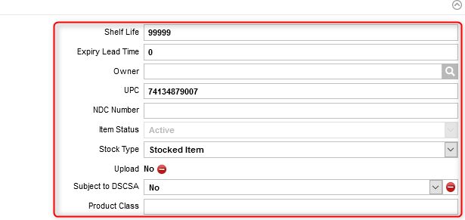
Items (WMS)
Enter the item configuration for the following fields. An explanation of the fields is given in the next slides.

Slide 56
Items (WMS)
(Continued)
Field | Explanation
Shelf Life | This is the shelf life of lot-controlled items in number of days. Used to calculate the default expiration date for receipts of the item/package code. For non-lot-controlled items, the system will set this value to 99999 days.
Expiry Lead Time | The number of days which are required before stock expires and is no longer available for picking and shipping. This is defaulted from the Host and may not be changed.
Owner | The owner of the item used for billing purposes when referencing this item in the EliteSeries Billing Management System (BMS).
UPC | The Universal Product Code for this item. This is defaulted from the Host and may not be changed.
NDC Number | The National Drug Code for the item. This is defaulted from the Host and may not be changed.

Slide 57
Items (WMS)
(Continued)
Field | Explanation
Item Status | This is the status of the item. All item that are newly created on the Host will have a default status of NEW - Newly Created by the Interface. The user must first set up the item's required WMS data fields prior to receiving the item in the warehouse. Part of setting up new items in the WMS is changing the status to RDY - Active. Once the status is set to RDY, the item can be received in the WMS.
Stock Type | The item classification differentiates regularly stocked items from non-stock items.
Upload | This field is automatically set to yes if the item was uploaded from the Host.
Subject to DSCSA | Indicates whether the item is subject to the transactional data required under the Drug Supply Chain Security Act laws. This is defaulted from the Host and may not be changed.
Product Class | Grouping of like items which may be used to generate planned cycle count.

Slide 58
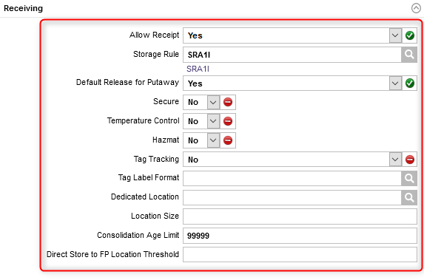
Items (WMS)
Enter the item attributes for receiving in the Receiving section. An explanation of the fields is given in the next slides.

Slide 59
Items (WMS)
(Continued)
Field | Explanation
Allows Receipt | This indicates if inventory of this item may be received.
Storage Rule | Assigned based on where the inventory should be stored.
Default Release for Putaway | This indicates if the item will be released for storage automatically during receiving. If Yes, as soon as a receipt line transaction has been closed out, system-directed putaway tasks will be generated and the inventory will be made available for putaway. If No, an explicit release for putaway must be invoked by the user to allow the product to be released to inventory, for products which require close inspection, quality assurance hold, etc.
Secure | Yes indicates the item requires a special storage method and/or handling to ensure security.
Temperature Control | Yes indicates the item must be stored or transported within a temperature-controlled environment.
Hazmat | This indicates if the item is classified as hazardous material.
Tag Tracking | Yes indicates that the item is tag-tracked
Tag Label Format | This is the label format to be used for tags printed for the item.

Slide 60
Items (WMS)
(Continued)
Field | Explanation
Dedicated Location | This is the preferred location for storing an item. The storage logic will use the value in this field if a requested location was not specified by the user and after having checked for potential cross dock entries for the item, but before performing any other searches. The dedicated location must be empty at the time of storage and the inventory must fit in the location based on weight and either location size or volumetric information.
Location Size | This field is matched to the Size field in the location when the system searches for a suitable storage location. When this field is assigned a value other than blank, the system will perform calculations based on the number of loads to determine if the inventory will fit into a location.

Slide 61
Items (WMS)
(Continued)
Field | Explanation
Consolidation Age Limit | This is the relative age, in number of days, that is used for consolidation. During location selection, inventory will not be consolidated with other inventory that differs in age by more than the consolidation age. Default value set to 99999.
Direct Store to FP Location Threshold | The threshold in days of the inventory received compared to existing inventory found in the warehouse. This field is optional. This is used by the storage logic to store inventory directly from the receiving dock to the FP location. If the value in this field is null, the current logic (storing directly into the FP location) will be used and any older inventory in the warehouse will be ignored. If the value is not null, the logic will take the received inventory item expiration date plus the threshold value and verify if there is older inventory in the warehouse. If older inventory exists, the new inventory received is not directed to the FP location, instead, the storage rule is invoked for that item to find an overstock location.

Slide 62
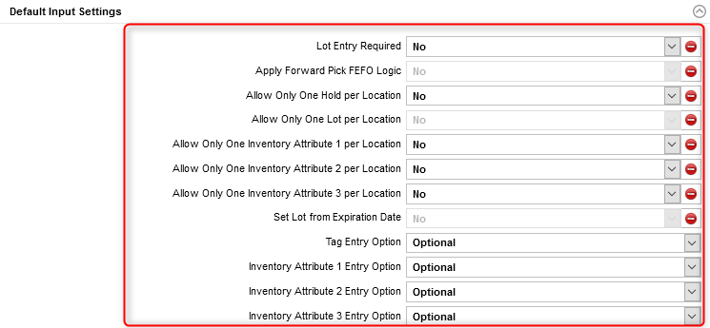
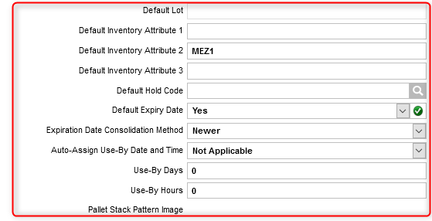
Items (WMS)
Enter the item attributes in the Default Input Settings section. An explanation of the fields is given in the next slides.

Slide 63
Items (WMS)
(Continued)
Field | Explanation
Lot Entry Required | This indicates if the item is a lot-controlled item and requires the user to enter the lot number at the time of inventory creation. This is defaulted from Host.
Apply Forward Pick FEFO Logic | This indicates which inventory to retrieve for the lot-controlled item at the order planning step. Yes indicates that FEFO (First Expired, First Out) logic will be used when allocating inventory for an outbound order line, therefore inventory with earliest expiration date will be pick before inventory with old expiration dates in the forward pick. No indicates that FIFO (First In First Out) logic will be used when allocating inventory for an outbound order line.
Allow Only One Hold per Location | This is used by the store function to determine if comingling of the same hold code for the same item is allowed. If it is set to Yes and the hold code for the item is different, then it will not be stored in the same location. No indicates that any hold code can be placed into the location with the same item.
Allow Only One Lot per Location | For lot-controlled items: If it is set to Yes, this determines that comingling of the same lot number for the same item is allowed and if the lot number for the item is different, then it will not be stored in the same location. No indicates that any lot number can be placed into the location with the same item.

Slide 64
Items (WMS)
(Continued)
Field | Explanation
Set Lot from Expiration Date | For lot-controlled items, a value of Yes indicates the expiration date will be populated in the lot column or the lot-controlled item.
Tag Entry Option | This is used to indicate whether this option is permitted during receiving and inventory status modifications. Relates to the receipt of pre-labeled inbound product, whereby it is required to scan the inbound tags or bar codes that will serve as internal license plates for inventory tracking purposes. No Changes Allowed indicates that users will not have the ability to change the default value for the specified field at the time of receiving. Not Allowed indicates that users will not have the ability to enter a value for the specified field at the time of receiving. Optional indicates that users have the option of entering a value for the specified field at the time of receiving. Required indicates that users will be forced to enter a value for the specified field at the time of receiving. This field is subsequently used to segment all inventory records within the system, in the background, for tracking purposes.
Default Lot | For lot-controlled items, default lot code to be used for the item during receiving.
Default Hold Code | The default hold code to be used for this item/package code during receiving.

Slide 65
Items (WMS)
(Continued)
Field | Explanation
Default Expiry Date | Yes indicates that the item expiration date will be equal to the receipt date plus the shelf life. No indicates that the item expiration date must be entered by the user. Defaulted from Host.
Expiration Date Consolidation Method | This is used when updating the item's expiration date when the inventory is being consolidated through the consolidation logic. Default is set to 0 – Destination. The following options are available: Destination indicates that the inventory records will be updated with the item expiration date of the inventory record currently in the destination location being consolidated. Older indicates that the inventory records will be updated with the older item expiration date of the inventory records being consolidated. Newer indicates that the inventories being consolidated inventory records will be updated with the newer item expiration date of the inventory records being consolidated.

Slide 66
Items (WMS)
(Continued)
Field | Explanation
Auto-Assign Use-By Date and Time | This identifies whether the item requires the application of the use-by date and time at the picking step. Not Applicable indicates that the option does not apply. Picked Only indicates that the use-by date and time will be applied at time of picking. The current date and time will be increased by the number of hours and days populated in the Use-By Days and Use-By Hours fields. Picked and Opened indicates that the use-by date and time will be applied to the full tag at time of picking. This is to accommodate products that are picked out of a sealed package (e.g. sterile or environment-protective) that not only require the picked product to receive a used-by date and time but also the remaining inventory in that package as well. This will be applied to the inventory picked and the remaining inventory associated to the tag that has been picked. The current date and time will be increased by the number of hours and days populated in the Use-By Days and Use-By Hours fields.
Use-By Days | The number of days the product must be consumed after it has been picked. Applies only if the Auto-Assign Use-By Date and Time flag is set to 1 or 2
Use-By Hours | The number of hours the product must be consumed after it has been picked. Applies only if the Auto-Assign Use-By Date and Time flag is set to 1 or 2

Slide 67
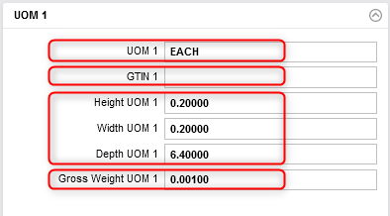
Items (WMS)
Enter the item unit of measure in the UOM 1 section.
Name of UOM 1, populated by the Host in the case of an upload item. This is the lowest unit of measure, common to both the Host and WMS.
The unique identifier according to the GS1 Global Trade Item Number standards, populated by the Host for an upload item.
The height, width, depth and weight for the UOM 1.
The level 1 gross weight of the specified unit of measure inventory.

Slide 68
Items (WMS)
In the same manner as in the UOM1 section, enter the item units of measure in the UOM 2 to 6 sections if applicable.
  Units of measure are used to define standard packing of items in the warehouse. Examples: each (individual piece), bag, box, case, pallet, etc.
  Note that UOMs 1 to 6 must be unique and gaps between them are not allowed.

Slide 69
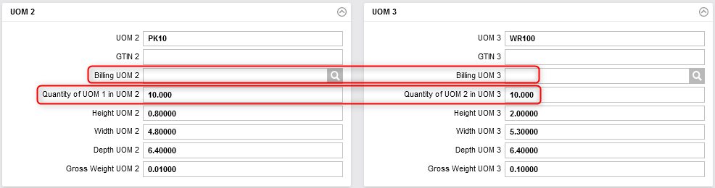
Items (WMS)
(Continued)
The unit of measure description used against UOM 3 for billing purposes in the EliteSeries Billing Management System.
The quantity of UOM 1 it takes to make one UOM 2.

Slide 70
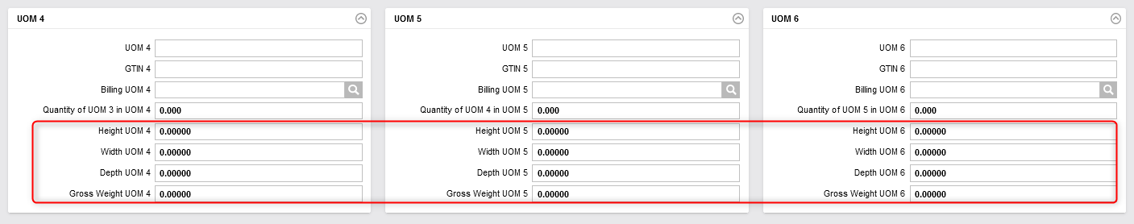
Items (WMS)
(Continued) Note that the height, width, depth and weight for any UOM that has not been defined in the UOM 2 to 6 sections should remain at 0.

Slide 71
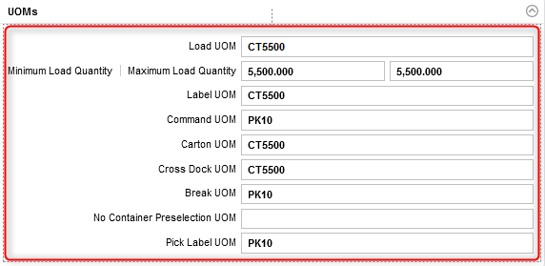
Items (WMS)
Enter the item attributes in the UOMs section. An explanation of the fields is given in the next slides.

Slide 72
Items (WMS)
(Continued)
Field | Explanation
Load UOM | The unit of measure that defines the maximum quantity of an item that will be received for each receipt record. Defines the unit of measure for which a tag ID is generated. The load unit of measure is the item's normal handling unit of measure that controls the creation of unique tags and inventory records at the time of receiving. The Load UOM must represent either UOM 1, UOM 2, UOM 3, UOM 4, UOM 5 or UOM6.
Minimum/Maximum Load Quantity | The minimum/maximum quantity (in the lowest unit of measure) of inventory that can be associated with a full load for the item.
Label UOM | The unit of measure for which tag labels are printed on a receipt record. The Label UOM must represent either UOM 1, UOM 2, UOM 3, UOM 4, UOM 5 or UOM6.
Command UOM | This controls how quantity information is communicated to users for all tasks. Commands are displayed to users in this unit of measure whenever possible. Commands are never shown in a higher unit of measure than the command unit of measure. The command must be issued as an even multiple of a defined UOM (no decimals/fractions).

Slide 73
Items (WMS)
(Continued)
Field | Explanation
Carton UOM | The unit of measure that defines a stocking carton.
Cross Dock UOM | The minimum unit of measure that can be cross docked for an item. Receipts less than this unit of measure are not considered for cross docking.
Break UOM | The lowest unit of measure that WMS can transact in for the item. This UOM may not be split into small units.
No Container Preselection UOM | For the specified unit of measure and higher, no picking container will be specified in the container selection algorithm defined in the container selection code table.
Pick Label UOM | The largest unit of measure for which a pick label will be printed.

Slide 74
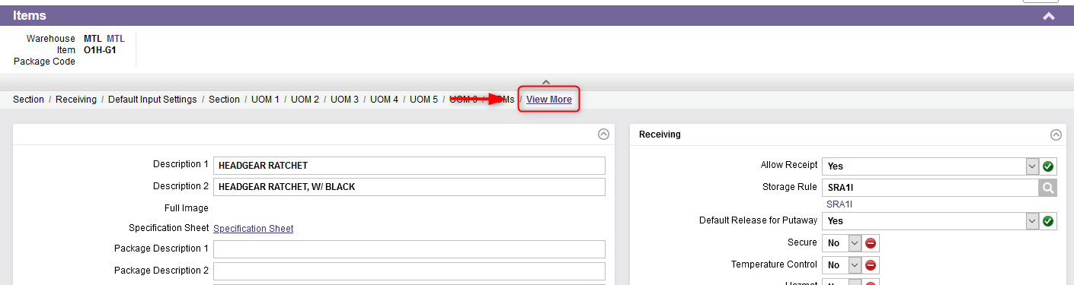
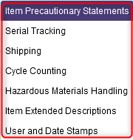
Items (WMS)
By clicking on "View More" at the top right of the resource, various other parameters can be configured if applicable: Item Precautionary Statements, Serial Tracking, Shipping, Cycle Counting, Hazardous Material Handling and Item Extended Description.

Slide 75
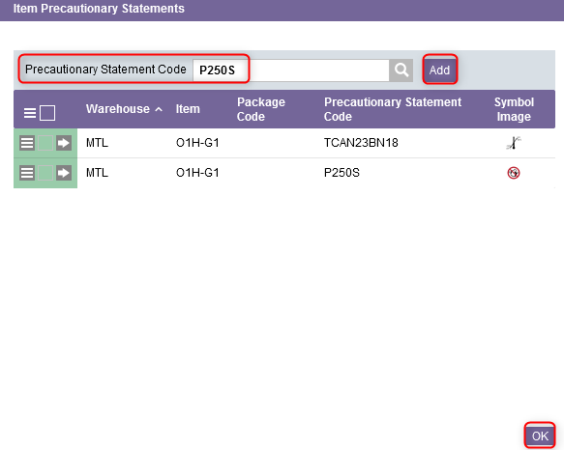
Items (WMS)
Click on Item Precautionary Statement:
  16.1 Enter a Precautionary Statement Code and click Add.
  16.2 Repeat step 16.1 for as many statements are required.
  16.3 Click OK when all Item Precautionary Statements are added.

Slide 76
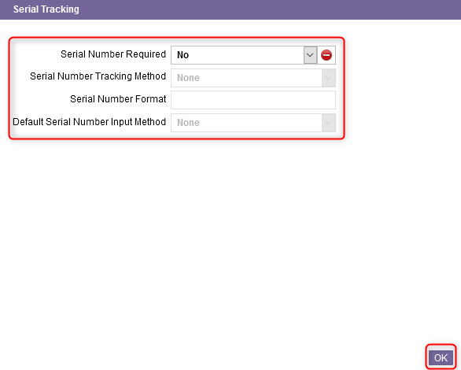
Items (WMS)
Click on Serial Tracking, complete the section for the fields shown below and click on OK once done. An explanation of the fields is given in the next slide.

Slide 77
Items (WMS)
(Continued)
Field | Explanation
Serial Number Required | This field Indicates if a serial number is required for this item. This field is defaulted from Host.
Serial Number Tracking Method | This is the tracking method used when processing serialized items. None indicates that serial number tracking is not required. Outbound Only indicates that serial number tracking is only required for shipping purposes. Full Serial Number Tracking indicates that full serial number tracking is required. Product adjustments and movement of the inventory throughout the warehouse are tracked using this method, and the location of each serial number in the warehouse is known and traceable.

Slide 78
Items (WMS)
(Continued)
Field | Explanation
Serial Number Format | The format in which the system determines the generation of the serial numbers when the use enters in a range or a starting serial number for the generation of a serial number range. The serial number format code is set up in the serial number formats table. Used when the item is a serialized item and that tracking is required.
Default Serial Number Input Method | This field represents the input method to be used when entering the serial numbers for serialized items. None - no entry is required Single Entry - single serial number entry is required. Start and End Entry Range - requires the entry of the starting serial number and ending serial number for the serialized item. Based on the range entered, the system will fill in the other serial numbers based on the start and end range. Open Entry Range - requires the entry of the start serial number and the quantity for the serialized item being processed in the entry function.

Slide 79
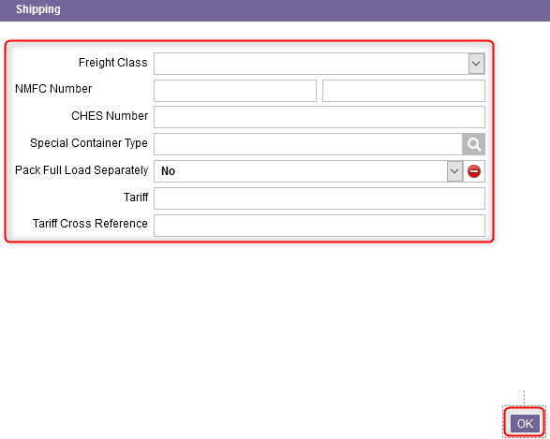
Items (WMS)
Click on Shipping, complete the section for the fields shown below and click on OK once done. An explanation of the fields is given in the next slide.

Slide 80
Items (WMS)
(Continued)
À
*These fields are optional.
Field | Explanation
Freight Class | The freight class for a less than truckload (LTL) shipment, as defined by the National Motor Freight Traffic Association. This value must be specified for each shipment package when an LTL carrier service is used.
NMFC Number* | The NMFC is the number defined by the National Motor Freight Association (NMFC) to identify each type of product that can be shipped by an LTL carrier. This number will print on the bill of lading, if provided.
CHES Number* | The hazardous material classification number. CHES number is a government agency number used by the electrical distribution industry and is a memo field.
Special Container Type | Wave release will assign this container type to picks for this item during container preselection and will exclude this item from the regular container preselection logic. When container preselection is used, and this field is supplied with a valid container type defined in the container types table, this container type will be used instead of the Container Selection Code assigned in the container selection code table.

Slide 81
Items (WMS)
(Continued)
*These fields are optional.
Field | Explanation
Pack Full Load Separately | A flag that indicates whether or not a container will be used for full load picking when the container preselection (CPRE) logic is enabled. Yes indicates that when a full load pick is required and the CPRE logic is enabled, the system will always assign a container using the LOAD container type for the full load pick. No indicates that when a full load pick is required, the system will not use the LOAD container type and will follow the standard CPRE logic to determine which container to use during picking.
Tariff* | The export tariff code for the item.
Tariff Cross Reference* | The export tariff code for the item. This is used for query purposes only.

Slide 82
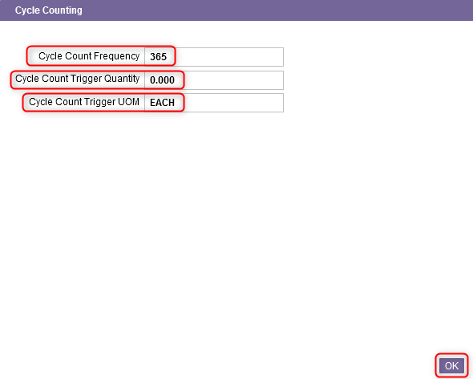
Items (WMS)
Click on Cycle Counting, complete the section for the fields shown below and click on OK once done.
The number of days between automatically scheduled cycle counts for an item. This field is used when the Automatic Cycle Count flag is set to Yes in the Warehouse Options resource.
The unit of measure for the quantity specified in the Cycle Count Trigger Quantity field. Default setting is UOM 1
When the remaining quantity of an inventory record falls to a level less than or equal to trigger quantity, the system will automatically generate a cycle count for the location.

Slide 83
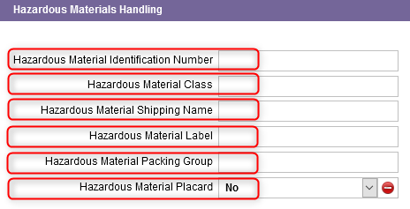
Items (WMS)
Click on Hazardous Material Handling, complete the section for the fields shown below and click on OK once done.
The UN or NA hazardous material classification*.
The hazardous material classification*.
The hazardous material proper shipping name for this item*.
The description used for hazardous labelling for the item*.
The hazardous material classification*.
A flag that indicates if the hazardous placards are required*.
*All these fields are optional.

Slide 84
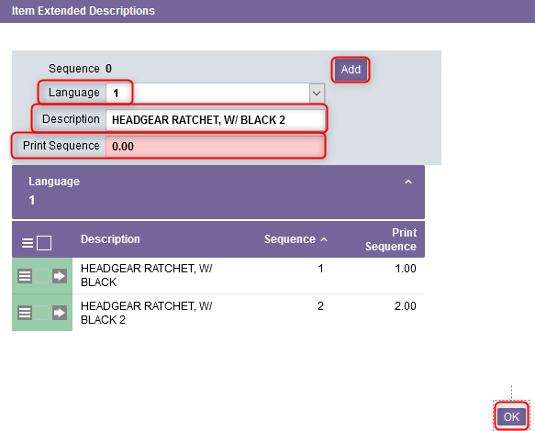
Items (WMS)
Click on Item Extended Description:
  21.1 Select 1 or 2 in the Language field, enter a Description and a Print Sequence.
  21.2 Repeat step 21.1 for as many descriptions are required.
  21.3 Click OK when all descriptions are added.
An explanation of the fields is given in the next slide.

Slide 85
Items (WMS)
(Continued)
Field | Explanation
Language | 1 indicates that language 1 item descriptions are to be used in the labels and documents sent to the customer. 2 indicates that language 2 item descriptions are to be used in the labels and documents sent to the customer. The value for this field originates in the host DMS.
Description | This is one line of extended description for the item.
Print Sequence | This value indicates the relative sequence of each line of the item's extended description on documents. Description lines can be added to an item in one sequence and printed in another.
Notes:
Description:

Slide 86

Items (WMS)
When the item is fully configured, change the status from "Newly Created by the Interface" to "Active“ in Item Status field.

Slide 87

Items (WMS)
Finally, click on Submit.

Slide 88

Items (WMS)
Additional Note – All items that are newly created on the Host will have a default status of “Newly Created by the Interface”. The user must first set up the item's required WMS data fields prior to receiving the item in the warehouse. Part of setting up new items in the WMS is changing the status to “Active”. Once the status is set to “Active”, the item can be received in the WMS. To do this:
Retrieve the new item created by the Host which has a "Newly Created by the Interface" status and click on View Record Details.

Slide 89
Items (WMS)
From the detail view of the item, in the Item Status field, change the Status to "Active” and click on Submit.

Slide 90
Item (TMS)
Back to the Table of Contents

Slide 91
Item (TMS)
The TMS Item resource contains details on products that are to be shipped.
This resource allows you to create an item, to update (add, modify, copy, delete) the record of a specific item or to query the records in the items table if desired.
Data in this table is typically used for Customs documents and LTL bills of lading.
Once captured in the TMS database, this information can be printed (when required) on shipping labels and shown within the system.

Slide 92

Item (TMS)
With a desktop computer, use the Transport Management menu.
Select the Transport Administration resource.
Under Transport Administration, click on TMS Masters.
Under TMS Masters, click on Item.

Slide 93

Item (TMS)
To update an item, perform a search to retrieve the item and click on View Record Details.

Slide 94



Item (TMS)
From the new window, three sections will appear: General, Hazmat, International.

Slide 95


Item (TMS)
Update only the Hazmat section for the fields shown below. An explanation of the fields is given in the next slide.

Slide 96
Item (TMS)
(Continued)
Field | Explanation
Hazmat | Indicate whether Yes or No the item is a Hazmat.
Hazmat ID | The hazardous material identification number for the contents of the package.
Hazmat 500 kg Exemption | Indicate whether Yes or No the 500 kg Exemption applies to the item.
Hazardous Material Class | The hazardous material classification used for the Hazmat. E.g. explosives, gases, flammable liquids, flammable solids, etc.
Hazmat Cargo Air | Yes indicates that the hazardous materials are all packed together in the same packaging. No indicates that the hazardous materials are not packed in the same packaging.
Hazmat Description | A description of the hazardous material.
Hazmat Shipping Name | The hazardous material proper shipping name for this item. Refer to the slide 25 for more details.

Slide 97
Item (TMS)
(Continued)
Field | Explanation
Hazmat Emergency Contact | The hazmat emergency contact (usually the company) name.
Hazmat Emergency Phone | The hazmat emergency phone number.
Hazmat Excepted Quantity | Small quantities of hazardous materials (typically samples) that may be shipped as an exemption to the regulations and just be marked with and Excepted Quantities Mark. Indicate whether Yes or No the Excepted Quantity rule applies to the item.
Hazmat Limited Quantity | The limited quantity is the maximum quantity per inner packaging or article for transporting dangerous goods as limited quantities. Indicate whether Yes or No the Limited Quantity applies to the item.
Hazmat Packing Group | The following options are available: 0 - No Packing Group Specified (default), 1 - Packing Group I, 2 - Packing Group II, and 3 - Packing Group III.

Slide 98
Item (TMS)
(Continued)
Field | Explanation
Hazmat Regulation | The type of regulation to which the hazardous material is subject.
Hazmat Regulation Set | Choose the appropriate regulation from the drop-down menu that applies to the item.
Hazmat Reportable Quantity | The reportable quantities of a Hazmat is the amount of that substance that has to be released before the Environmental Protection Agence requires notification to go to the National Response Center. These quantities are based on volume. Indicate whether Yes or No this applies to the item.
Hazmat Quantity | Indicates the net quantity of the hazardous materials shipment being shipped.
Hazmat UOM | The unit of measure associated with the hazardous material quantity specified.
MSDS | The identifier of the Material Safety Data Sheet associated to the item.
NFPA H-F-R-S/N | The NFPA number associated to the item.

Slide 99

Item (TMS)
Once all the required fields in the Hazmat section have been completed, click Submit.
Click on Close to exit the TMS Item resource.

